Slide 1
Rockbuster Stealth: Data Analysis Project
Prepared By: Rob Rowland
3 February 2022

Slide 2
Project Overview
Context:
Rockbuster Stealth LLC is a movie rental company that used to have stores around the world. Facing stiff competition from streaming services such as Netflix and Amazon Prime, the Rockbuster Stealth management team is planning to use its existing movie licenses to launch an online video rental service in order to stay competitive.
Key Questions and Objectives:
Which movies contributed the most/least to revenue gain?
What was the average rental duration for all videos?
Which countries are Rockbuster customers based in?
Where are customers with a high lifetime value based?
Do sales figures vary between geographic regions?

Slide 3
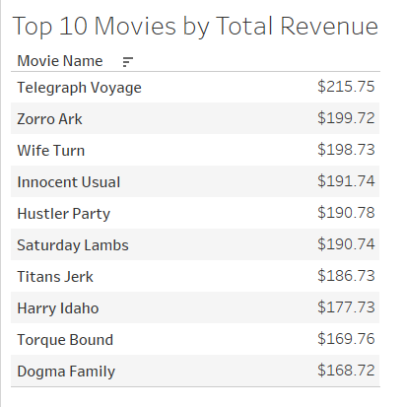
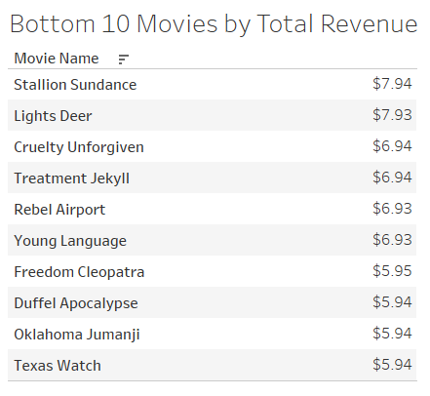
Which movies contributed the most/least to revenue gain?

Slide 4
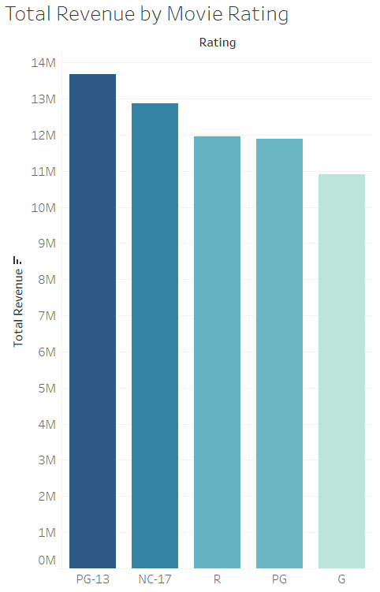
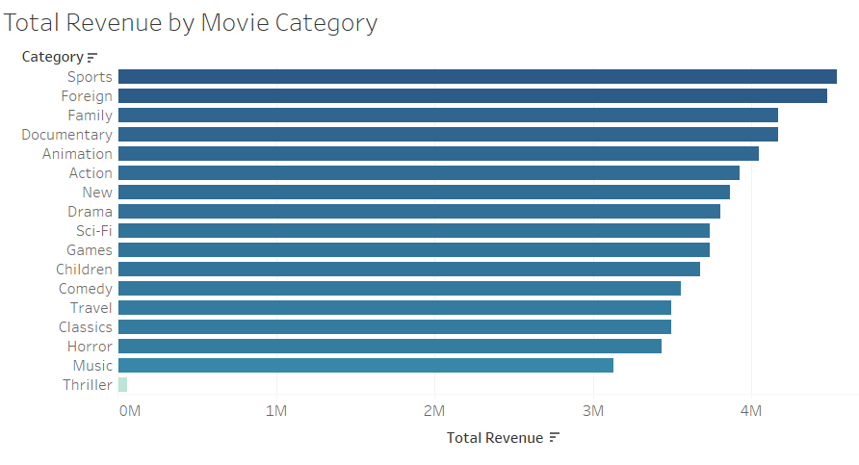
Which movies contributed the most/least to revenue gain?

Slide 5
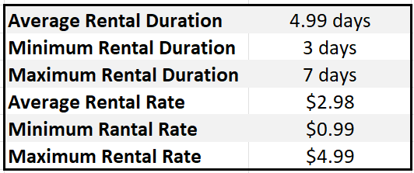
What was the average rental duration for all videos?

Slide 6
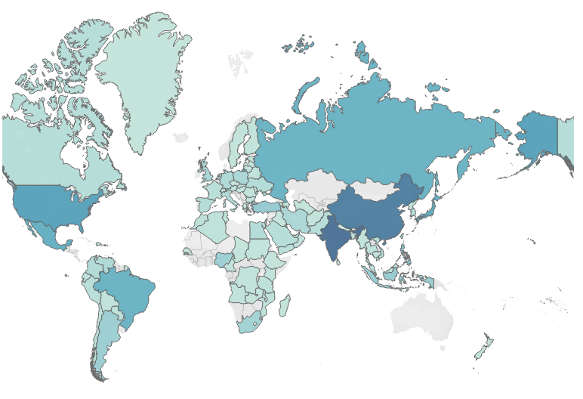
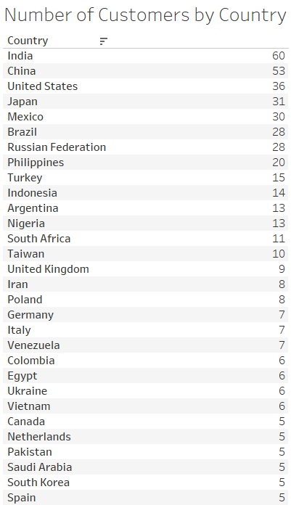

Which countries are Rockbuster customers based in?

Slide 7
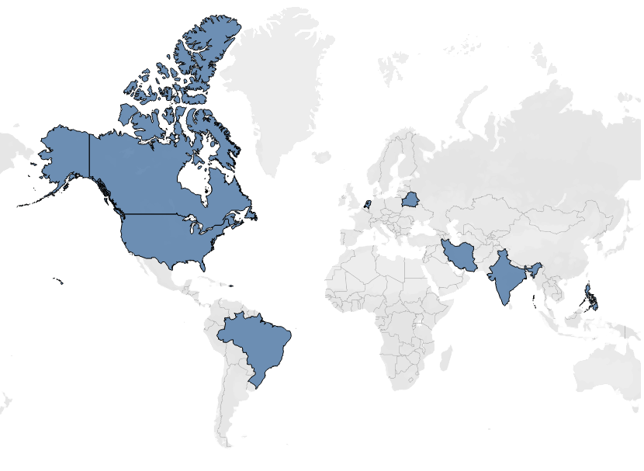
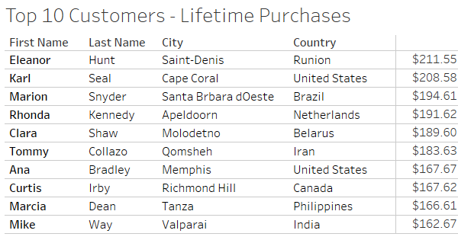
Where are customers with a high lifetime value based?

Slide 8
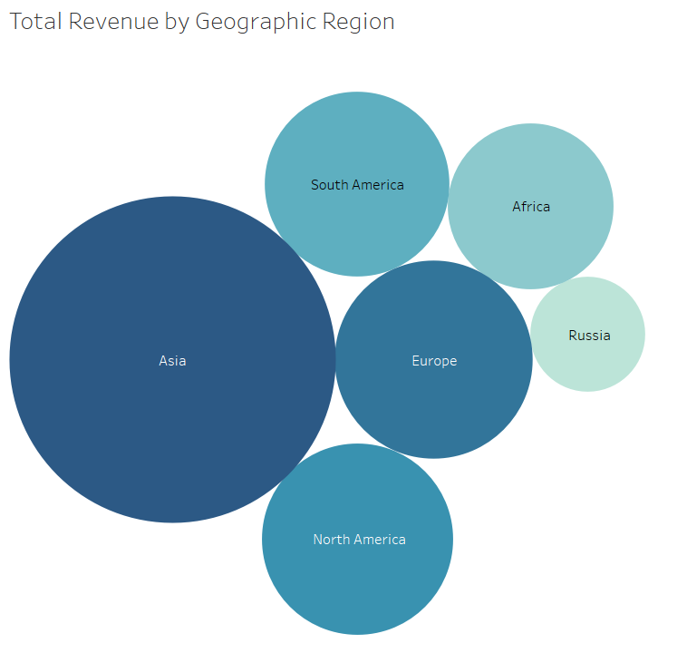
Do sales figures vary between geographic regions?

